Slide 1
Summative Pre-Work – Jan 14 (ICS3C)
Agenda
Summative Pre-Work
Select only one of the programming options
Complete your program by Thursday
Marks Spreadsheet
Review / Complete missing work
Upcoming
Thursday, Jan 17: Course Review / Organization
Friday, Jan 18: Summative Part 1
Mon-Wed, Jan 21-23: Summative Parts 2 & 3

Slide 2
Coder / De-Coder – Jan 10 (ICS4C)
Agenda
Convert Module B.7 to Java
Module B.7 Coder / De-Coder
Level 1 / 2 – Complete Yesterday
Level 3 – Complete by Tomorrow
Unity Game
Continue Tutorials
Plan & Design
Upcoming
January Schedule

Slide 3

Substitution Code
Google “Substitution Code”

Slide 4
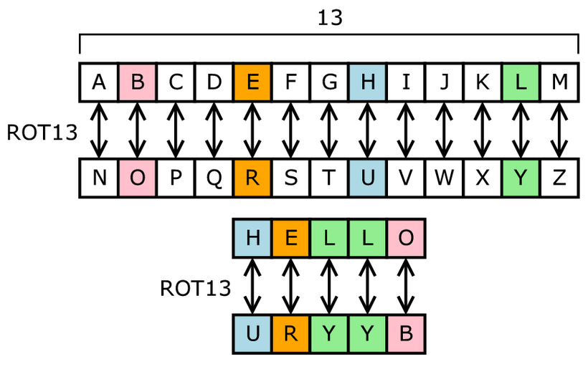
Substitution Code
Google “Substitution Code”

Slide 5
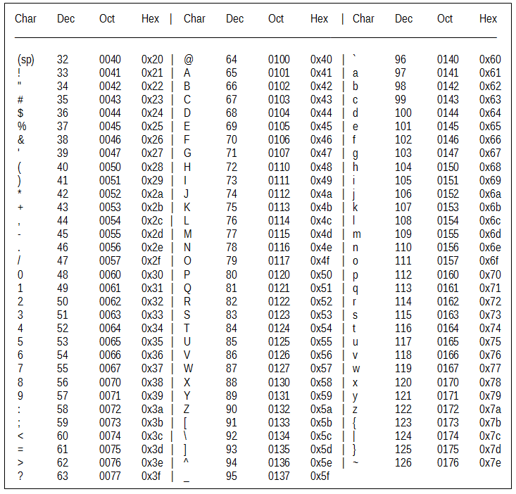
Decode This Message
73 32 104 111
112 101 32 121
111 117 32 119
105 108 108 32
101 110 106 111
121 32 111 117
114 32 110 101
120 116 32 97
115 115 105 103
110 109 101 110
116 33

Slide 6
Decode This Message
73 32 104 111
112 101 32 121
111 117 32 119
105 108 108 32
101 110 106 111
121 32 111 117
114 32 110 101
120 116 32 97
115 115 105 103
110 109 101 110
116 33

